Slide 1

Deepan Sanghavi
Dhaval Dholakia
Karan Somaiah Napanda
Rohitpal Singh
Satishraju Rajendiran
Sushma Tayanna

Slide 2
What is smart city
Urban development vision
To integrate multiple information and communication technology (ICT) and Internet of Things (IoT) solutions in a secure fashion to manage a city's assets .
Goal of a Smart city: Improve quality of life by using urban informatics and technology to improve the efficiency of services and meet residents' needs.
Why crime?

Slide 3
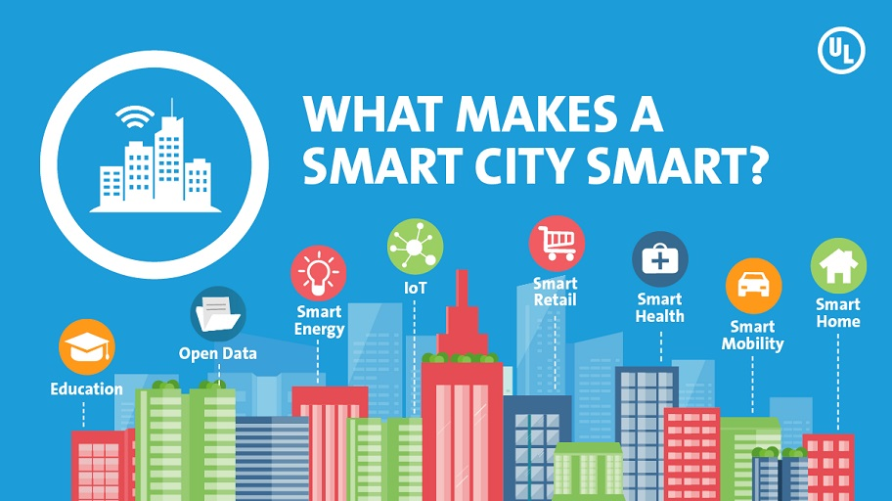
Notes:
Different image for security

Slide 4


Objective:
Crime Data Analysis:
The goal here is to develop a model based on the
crime data.
Help the authorities to make effective decision
(by providing insights about data) .
Implement effective strategy to keep the city safe
and evolve as a smart city.
City of Interest: Chicago
Notes:
Combine crime data analysis into 1-2 slides

Slide 5

Urban development vision
To integrate multiple information and communication technology (ICT) and Internet of Things (IoT) solutions in a secure fashion to manage a city's assets .
Goal of a Smart city: Improve quality of life by using urban informatics and technology to improve the efficiency of services and meet residents' needs.

Slide 6

Crime Data Analysis
Providing safety is crucial to improve the quality of life
in the cities.
Public security is a growing problem for cities worldwide
The world’s cities are bursting at the seams, civic resources are under pressure and crime is harder than ever to police.
With increasingly smarter statistical analysis and access to data:
We will be able to foresee and percept various types of criminal acts at a particular time and location, before they even occur.

Slide 7

Crime Data Analysis
Enables city authorities to detect areas of increased
crime
Opportunity to act more deliberately and deploy
officers more intelligently.
For Ex: Sending them to areas that are more exposed to crime.
With such systems, police officers will :
a) Not only respond to criminal acts
b) But will be able to act proactively and stop them before they occur.

Slide 8



Crime Data Analysis
Positive effects on life in city , For Example:
For law enforcement authorities- Higher rate of detecting crime, automatic detection of crime, better responsiveness to it, more efficient operations, optimizing budget, etc.
For cities: Less crime, more attractive for investors, companies and human resources, etc.
For residents: Safer neighborhoods, faster access to safety information etc.

Slide 9
Crime Data Analysis – Chicago

Slide 10
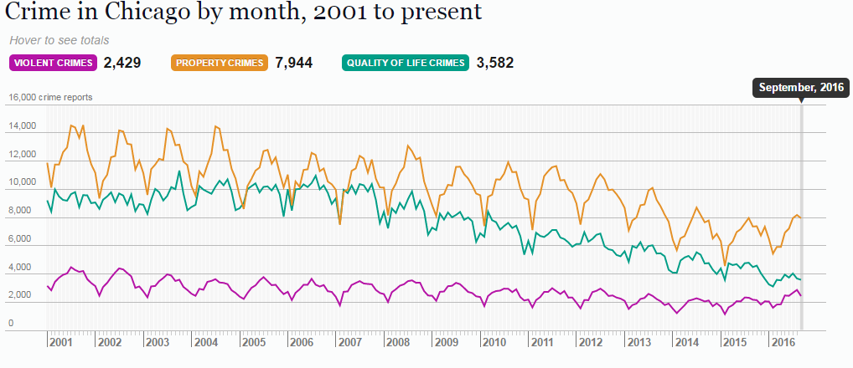
Why Chicago ?
Why Chicago?
Chicago is

Slide 11
Data Collection
Crime data
Police data
Real Estate*
Restaurant data
Yelp Ratings

Slide 12
Data Description
Source : https://data.cityofchicago.org/
Dataset Size:
Total Records 6,193,548 (2001 - 2016)
Variables : 21
Chicago Crime Dataset
Time
Crime Type
Location
Notes:
Data Collection before data descriotion

Slide 13
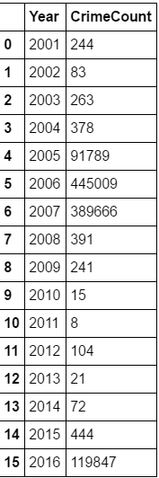
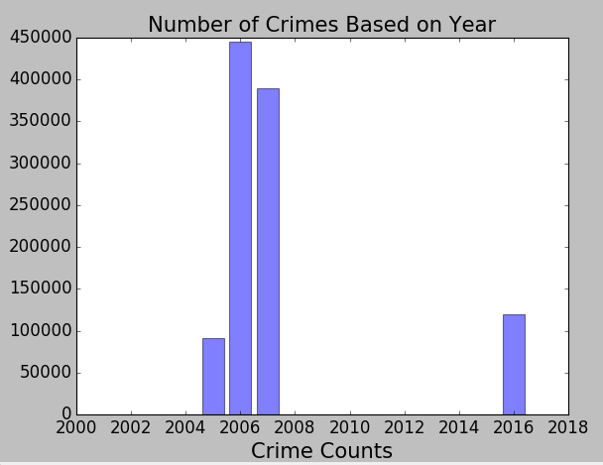

Slide 14
Data Description
ID
Case Number
Date
Block
IUCR
Primary Type
Description
Location Description
Arrest
Domestic
Beat
District
Ward
Community Area
FBI Code
Hour
DayofWeek
Year
Day
Month
Updated On
Latitude
Longitude
Location
Timestamp
ImpBlock
6,193,548
Break Down Timestamp by
Day of the week(weekend or weekday)
Time of the Day
Discretization of hour
Year Month Day
ImpBlock
Obtain Zip codes by location
1048575 Observations
29 Variables

Slide 15
Data Limtations
Data was skewed.
2001 – 2009
2010
2011 – 2016
Null values
Drop NA
No Personal info

Slide 16
Problem
A model that would predict/answer the following questions:
Catch me if you can
Domain(Time, location) where you should increase the security to reduce the crime rate
Identify the type of crime for which the accused was never tracked down.
Predict the type of crime for given time and location
Classify the region as safe/unsafe .
Why a specific region is tied to specific crime type?

Slide 17
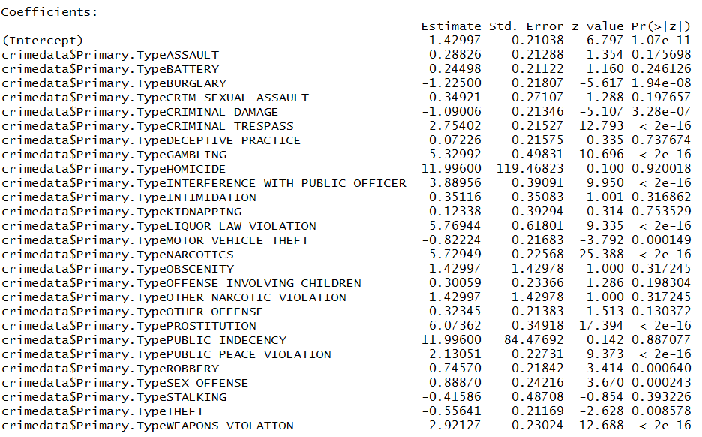
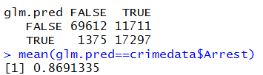
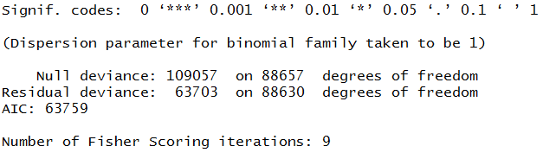
Approaches Tried:
Model:
glm.fit=glm(Arrest∼crimedata$Primary.Type+crimedata$IUCR, data=crimedata ,family=binomial,subset=train)

Slide 18
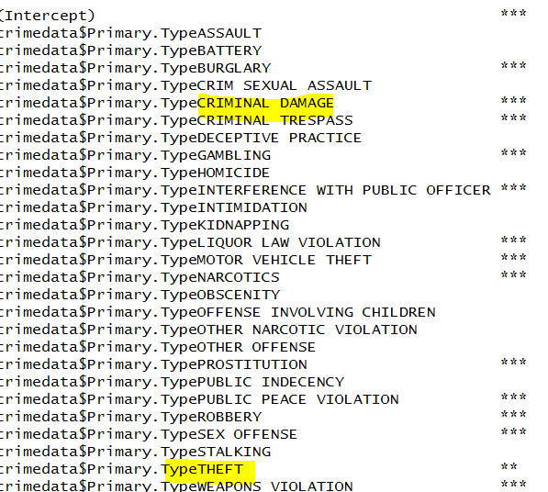
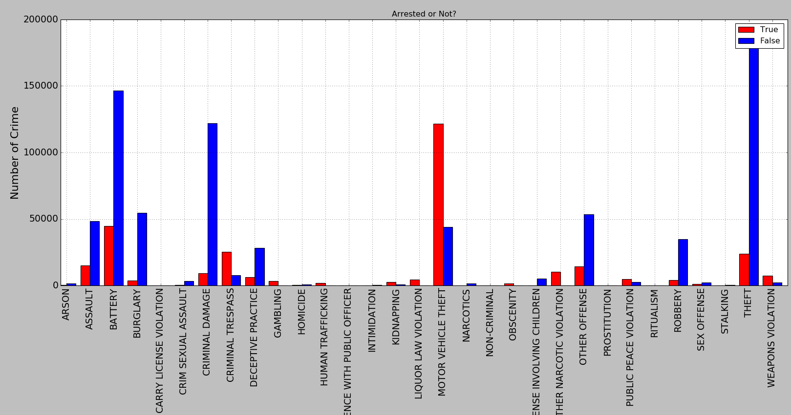
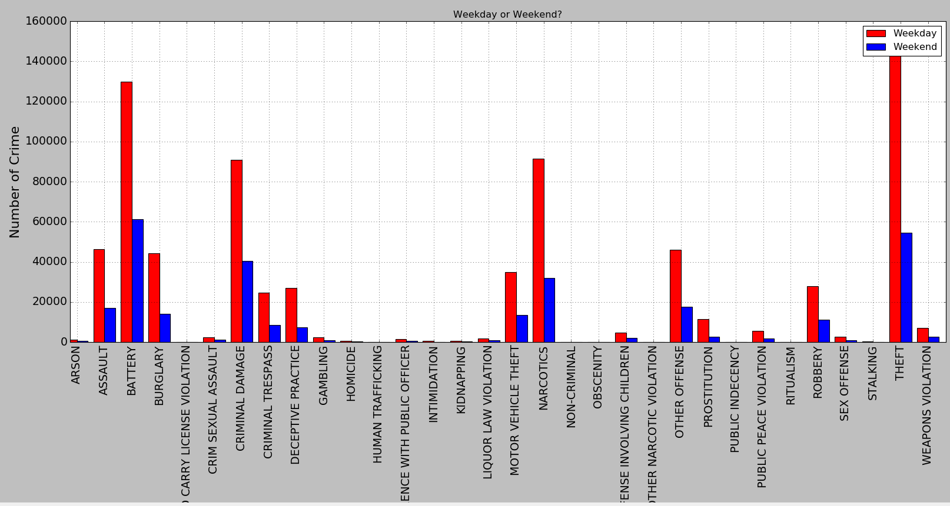

Slide 19
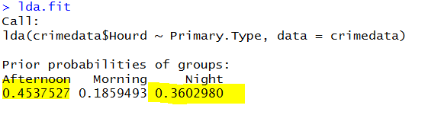


LDA: lda.fit=lda(crimedata$Hourd~Primary.Type, data=crimedata)

Slide 20
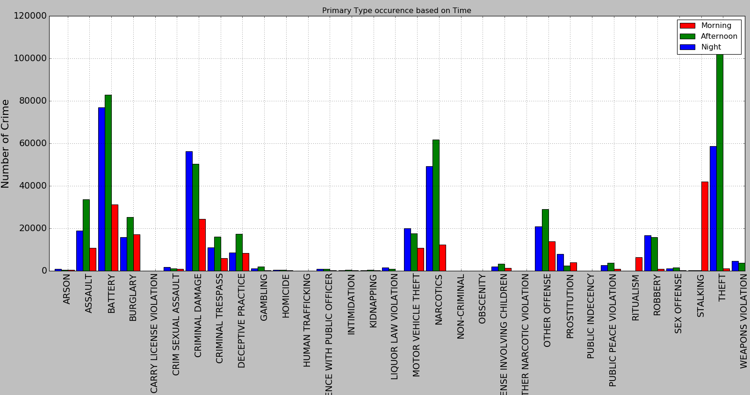
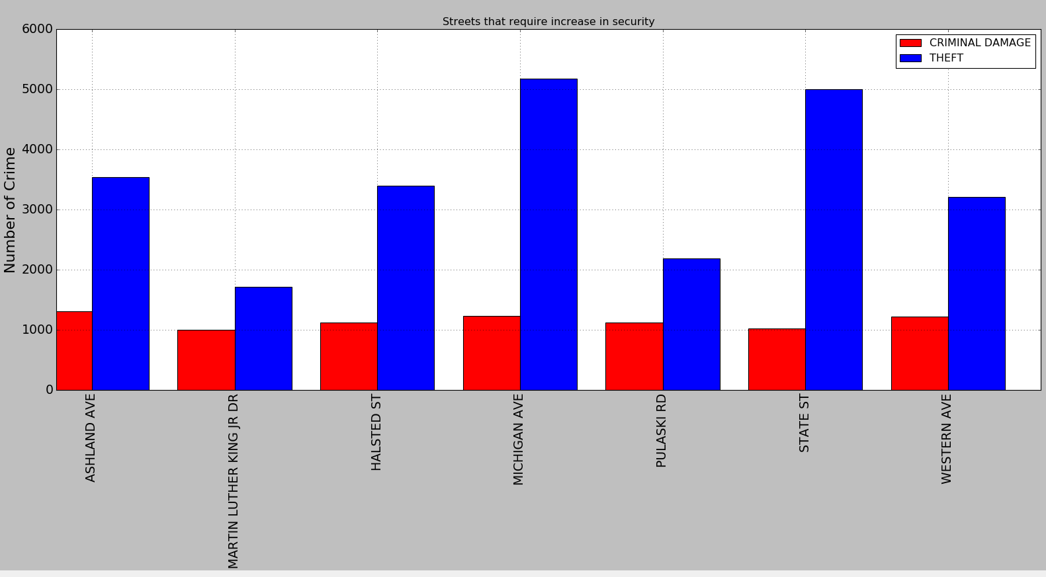

Slide 21
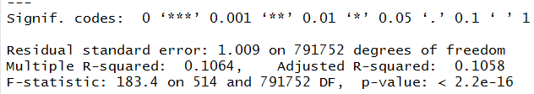


2 question
lm.fit=lm(crimedata1$CrimeCount∼crimedata1$District+crimedata1$Ward+crimedata1$Year+crimedata1$DayofWeekd+crimedata1$Hourd+crimedata1$Month+crimedata1$Location.Description+crimedata1$IUCR)
lm.fit=lm(crimedata1$CrimeCount∼crimedata1$IUCR+crimedata1$Location.Description+crimedata1$DayofWeekd+crimedata1$Community.Area) [Preprocesssing]
Notes:
How we got the target column; result with crime count 1; then above results after removing low crime count values

Slide 22
All visualization
To prove night result

Slide 23
Final Approach

Slide 24
Why We Chose this approach

Slide 25
Results

Slide 26
Interpretation of results

Slide 27
Analysis By Type

Slide 28
Analysis By Time

Slide 29
Analysis by Time

Slide 30
Analysis by location

Slide 31
References:
http://crime.chicagotribune.com/
https://data.cityofchicago.org/

Slide 32
Conclusion

